Slide 1
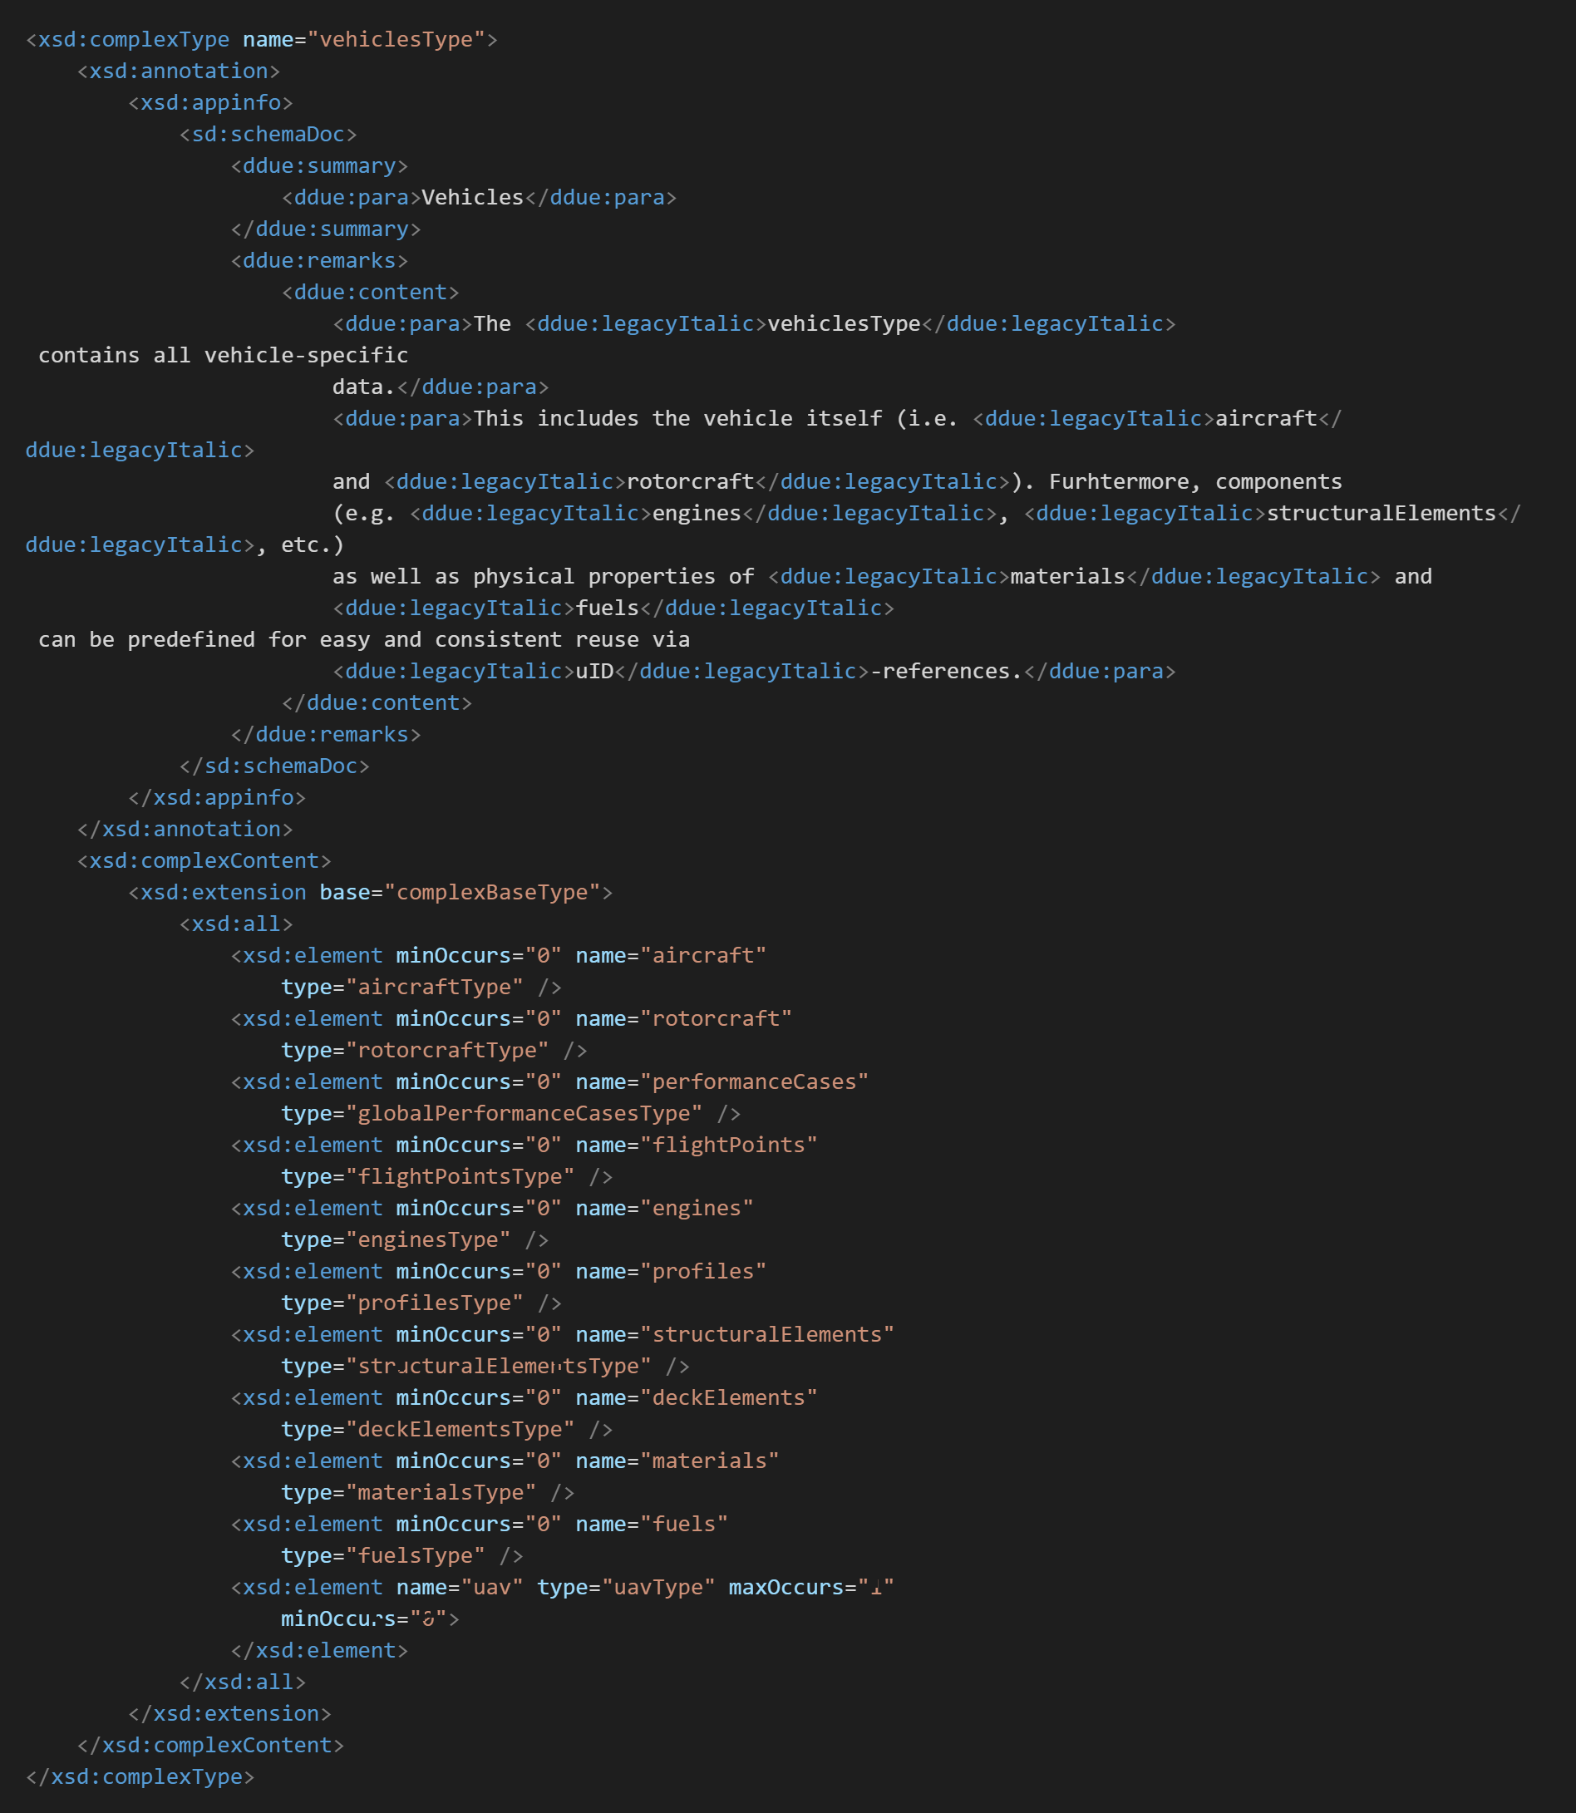
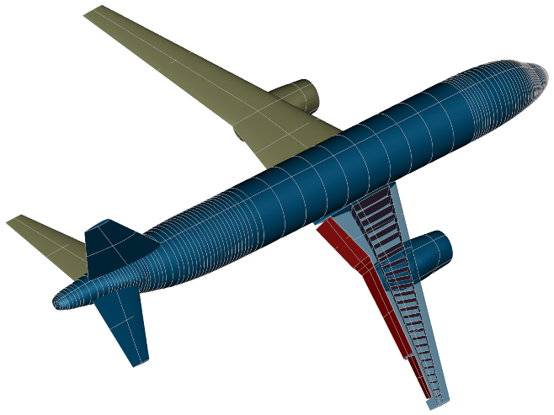
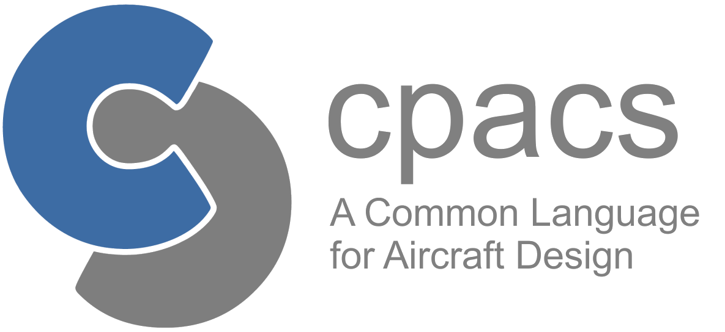
Introduction to CPACS
M. Alder
Institute of System Architectures in Aeronautics
Aircraft Design & System Integration

Slide 2
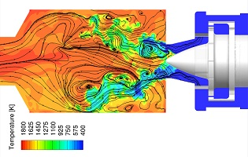
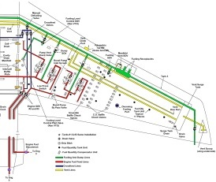
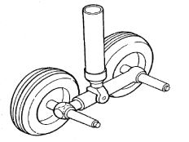
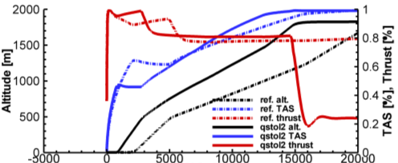
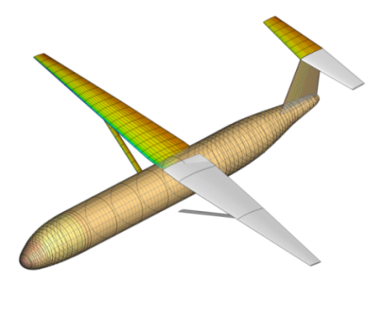
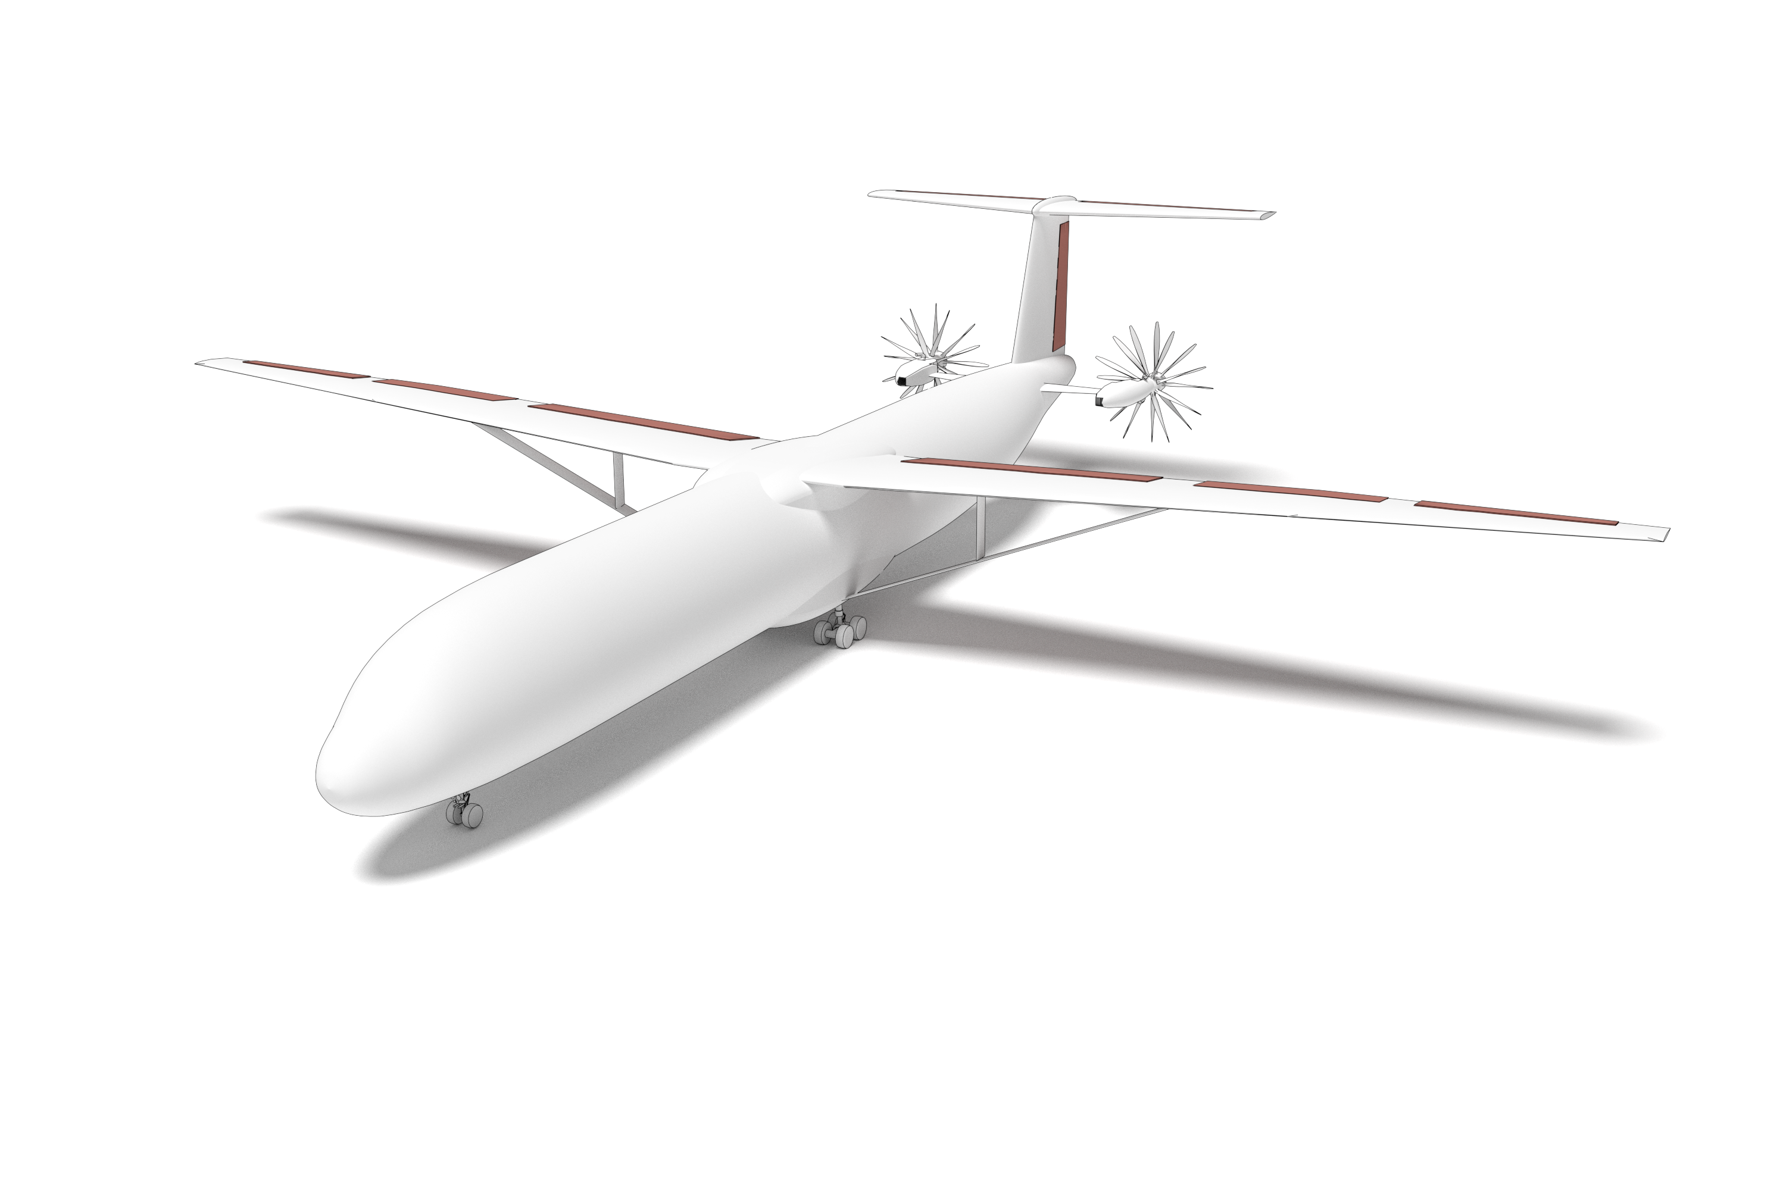
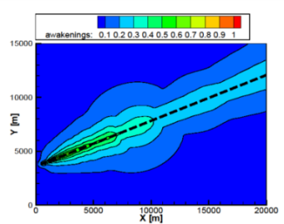
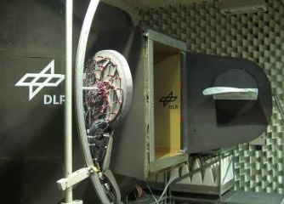
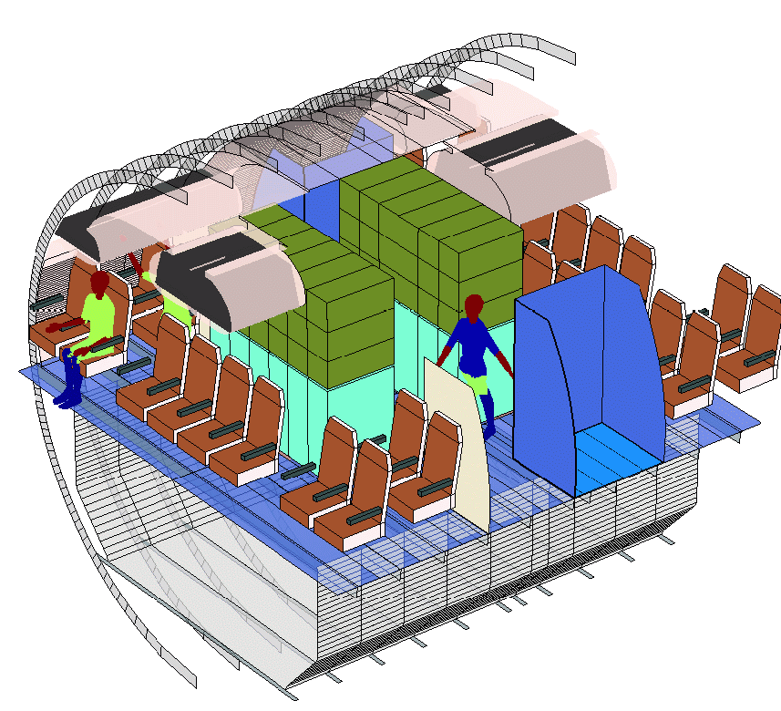
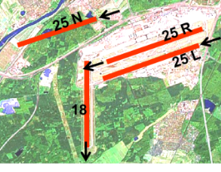
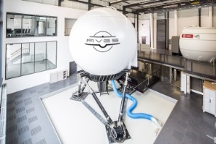
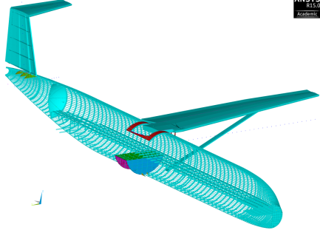
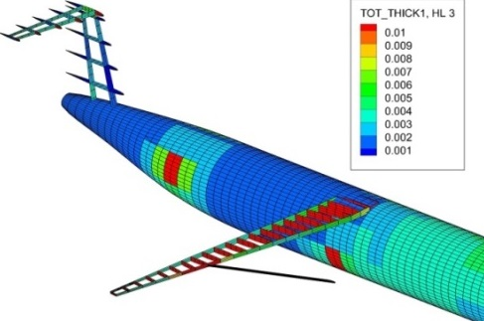
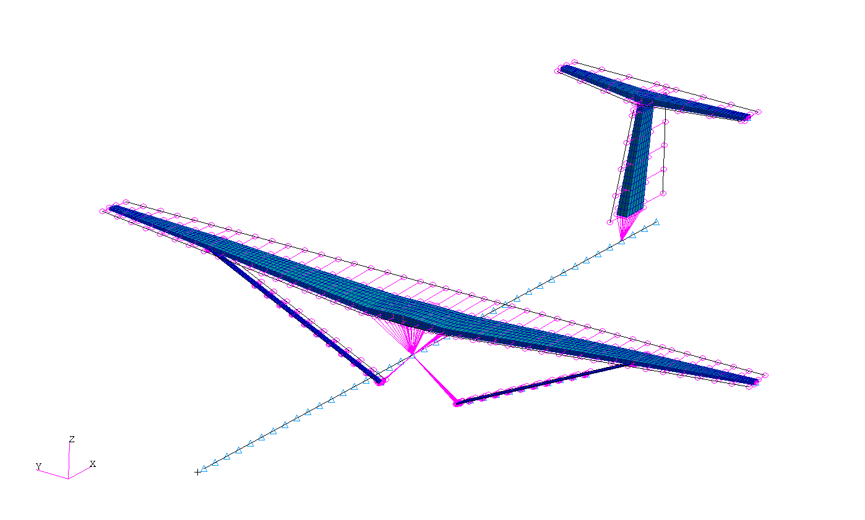
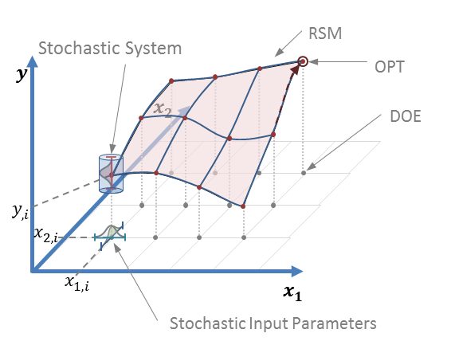
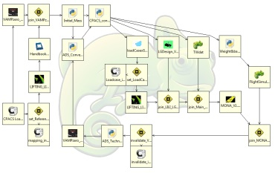
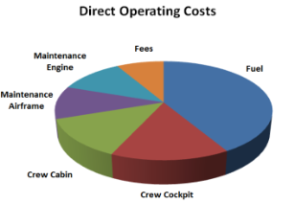
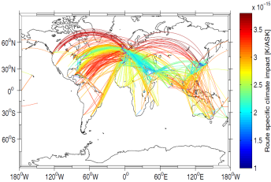

Slide 3
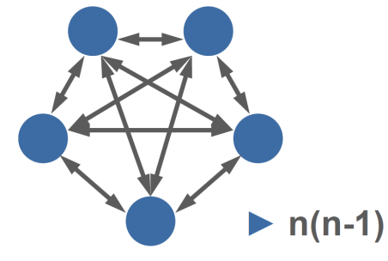

Slide 4


Common Parametric Aircraft Configuration Schema

Slide 5

Introduction to CPACS
Bildquelle hier angeben

Slide 6
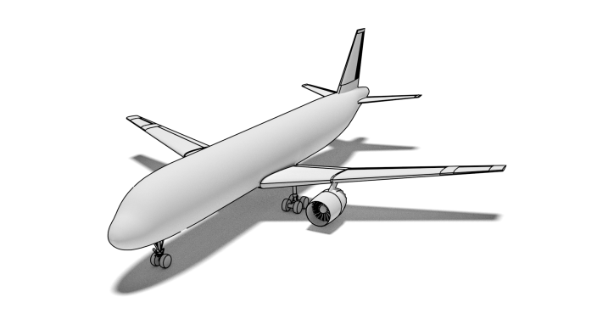
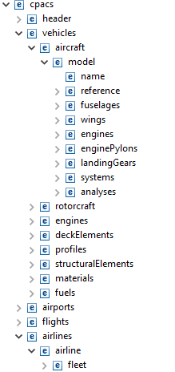
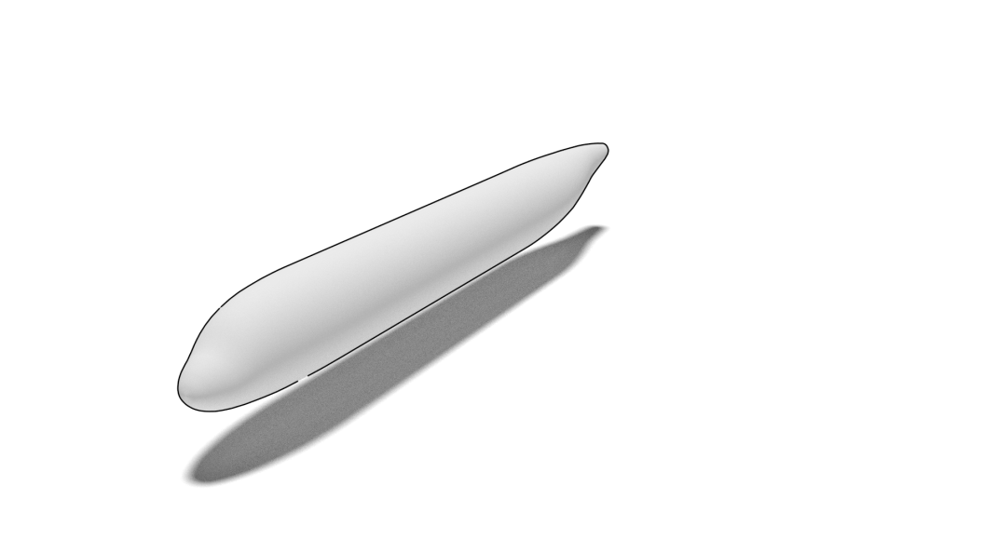
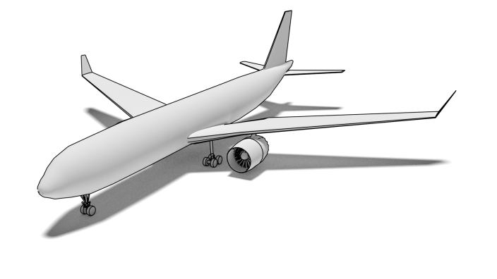
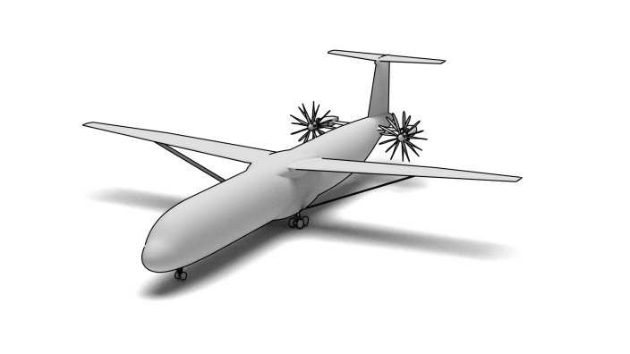
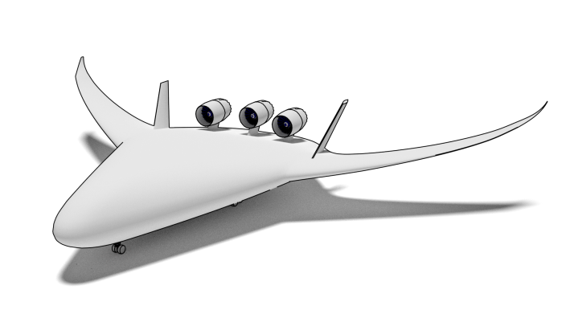
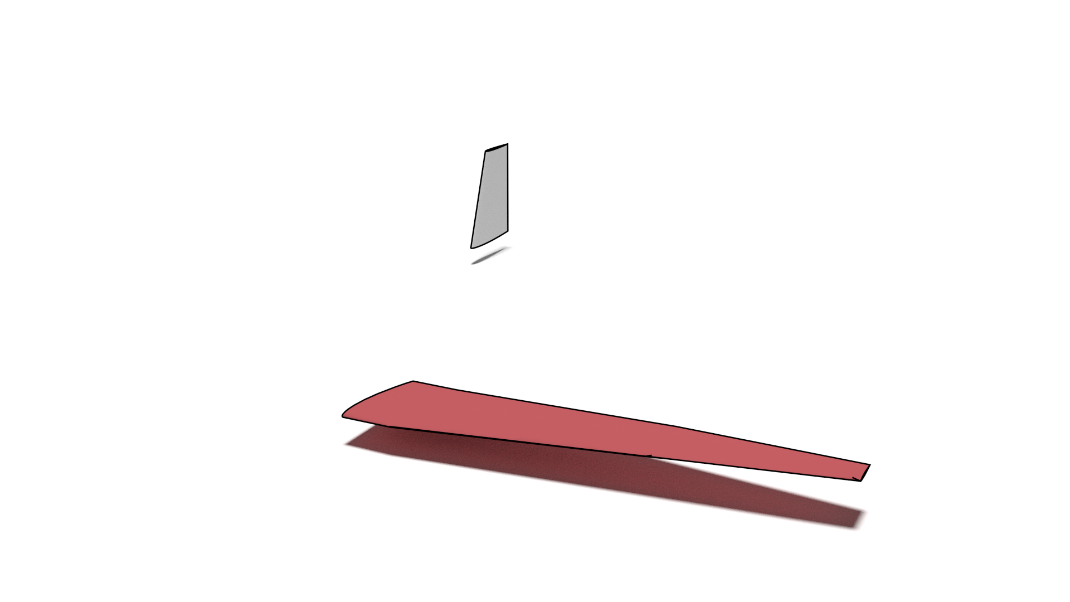
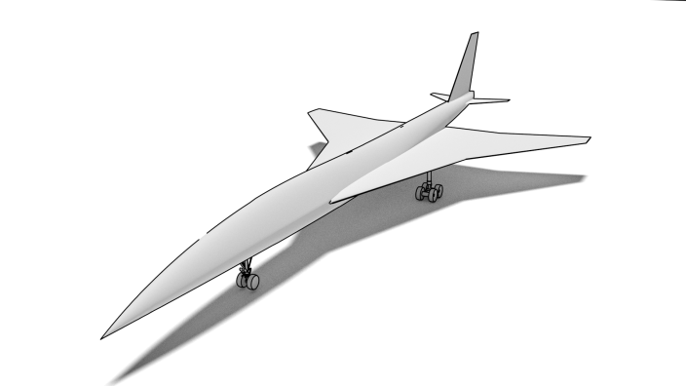
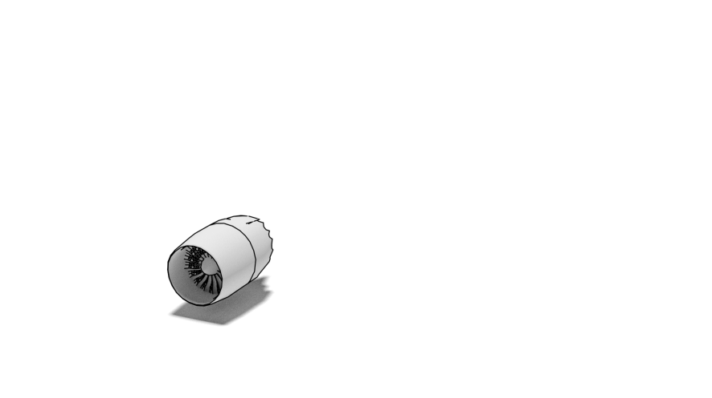
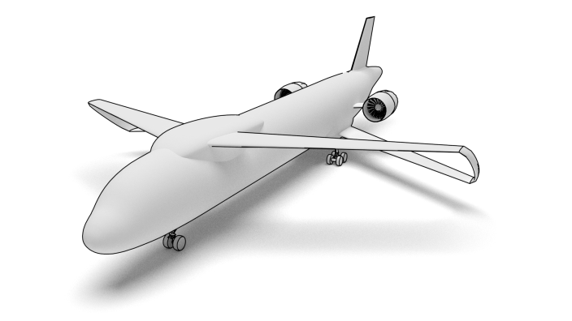
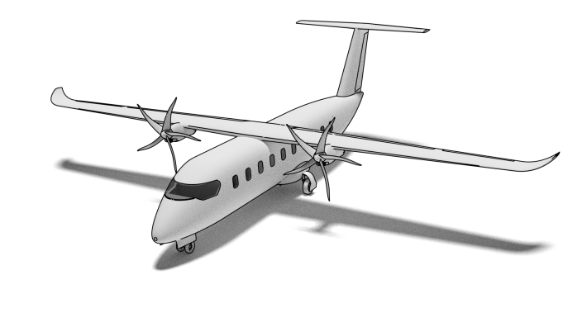
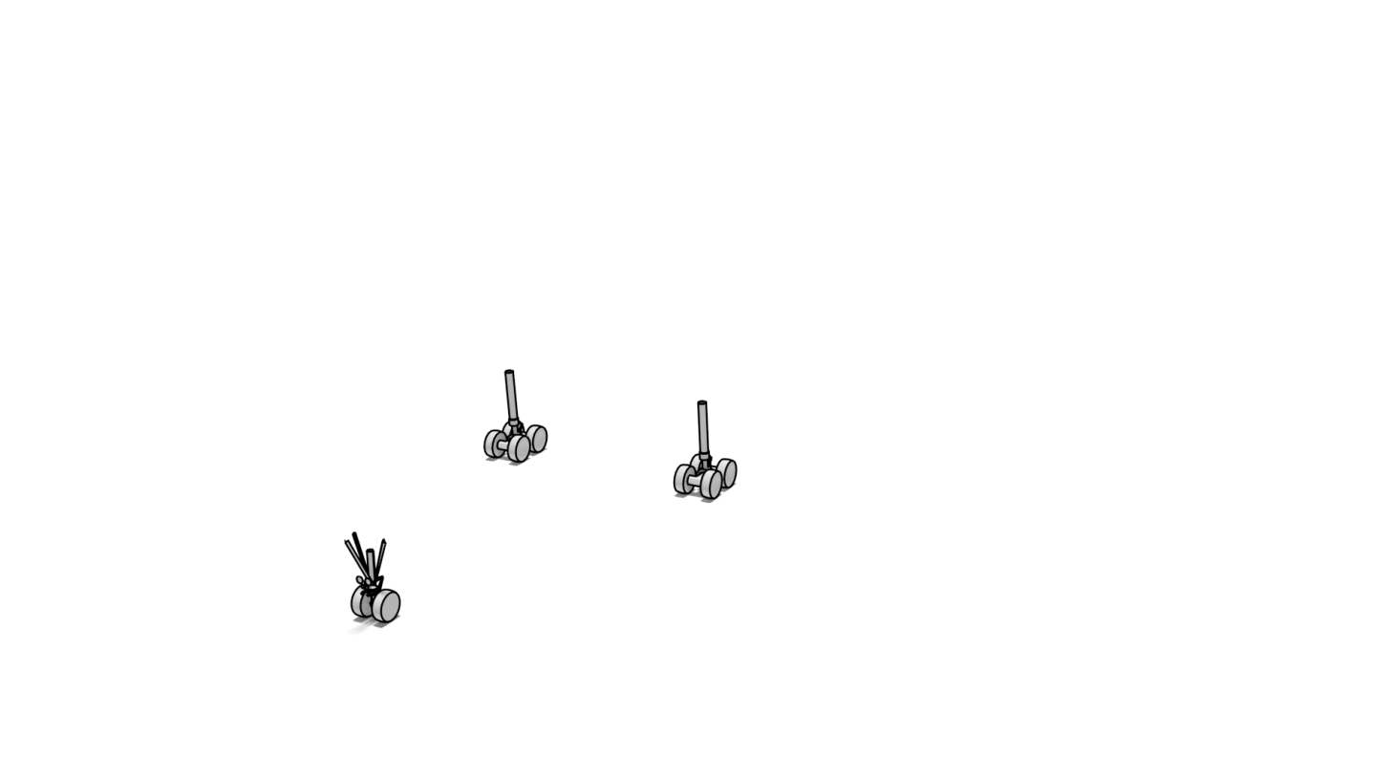
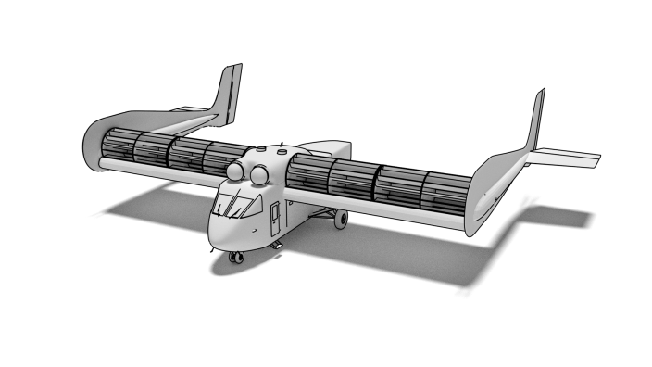

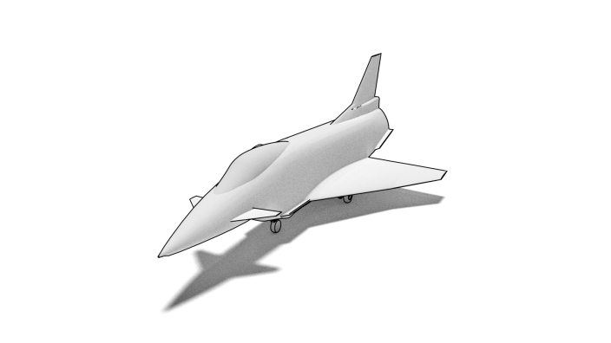
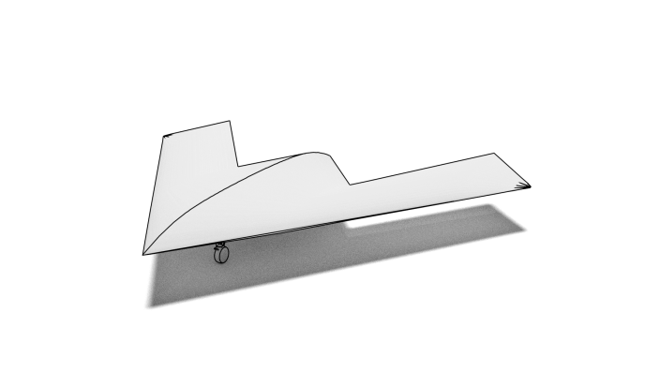
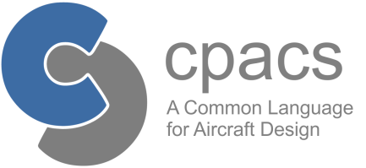
Introduction to CPACS
Hierarchical Structure
top level
2. level
3. level

Slide 7
Introduction to CPACS
Hierarchical Structure
top level
2. level
3. level

Slide 8
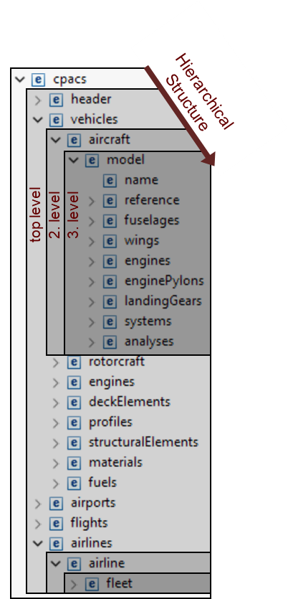


Introduction to CPACS
Common language for aircraft design
Exchange of specialist knowledge
Developed since 2005, based on XML / XSD
Human readable
Standardized
Open-source

Slide 9

Introduction to CPACS
Common language for aircraft design
Exchange of specialist knowledge
Developed since 2005, based on XML / XSD
Human readable
Standardized
Open-source
Supporting libraries:
TiXI: fast & simple XML Interfacing
TiGL: Geometric Library (based on OpenCASCADE)
- query functions: tiglGetWingArea
- export to IGES/VTK
- geometry viewer
external interfaces for: C, C++, Python, Java, MATLAB and Fortran

Slide 10
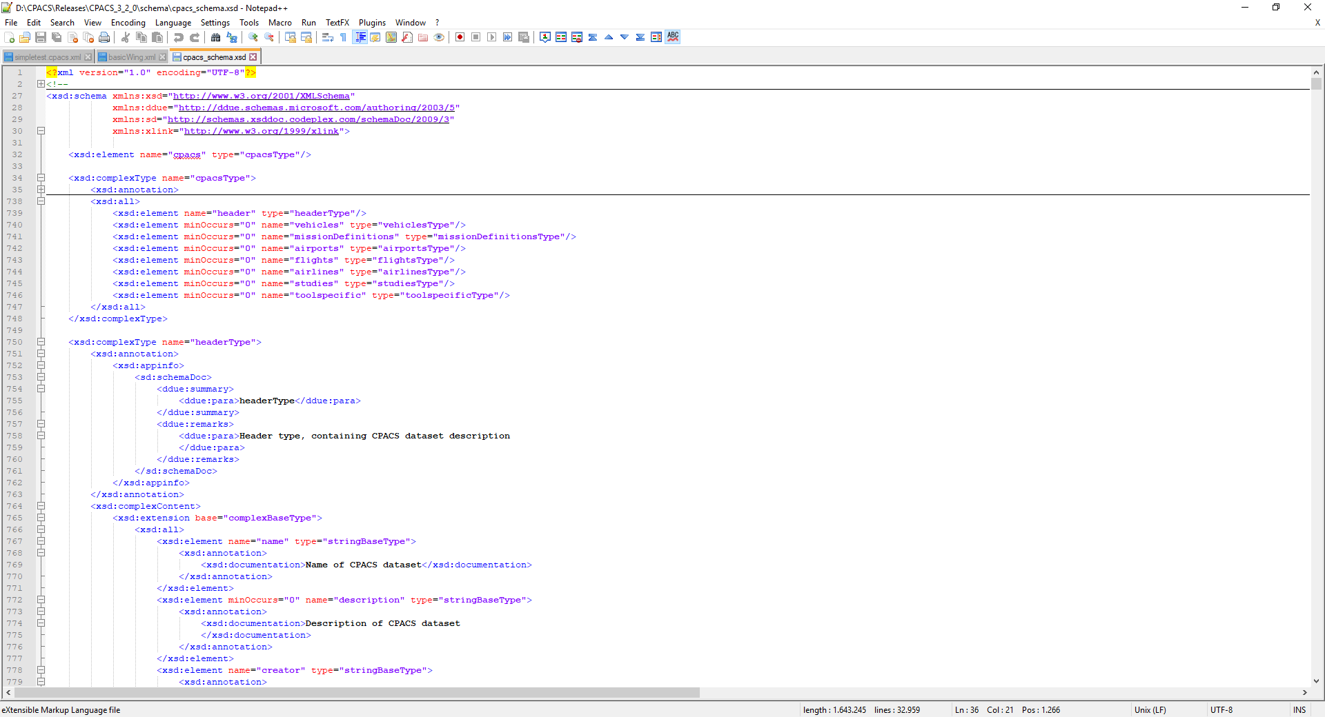
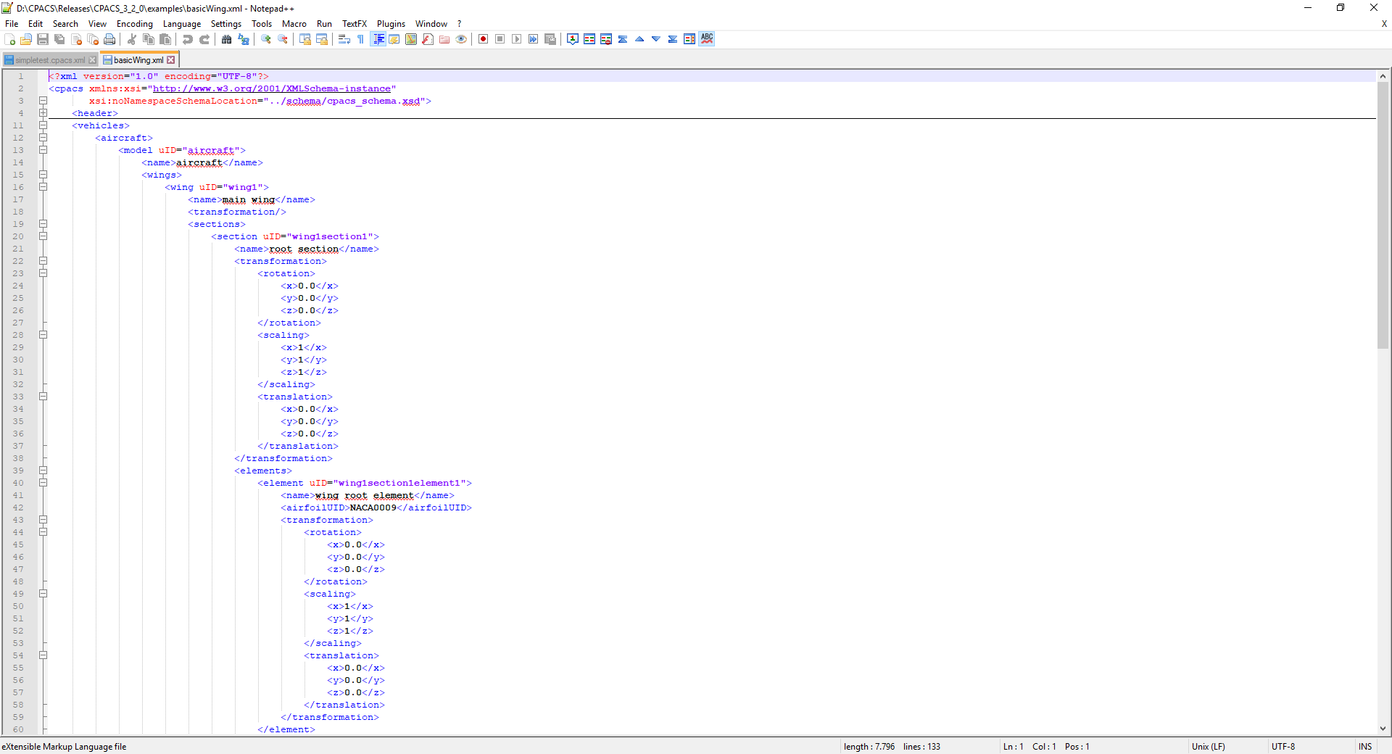
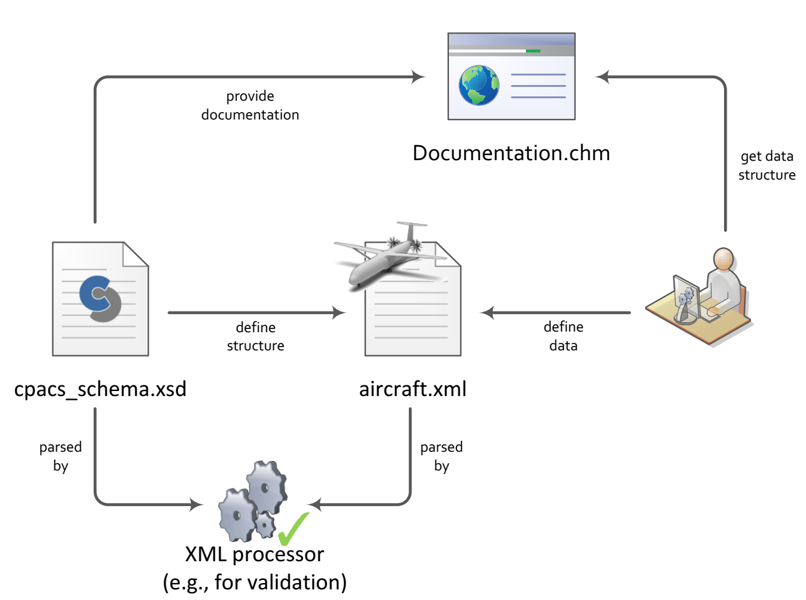
CPACS utilization

Slide 11
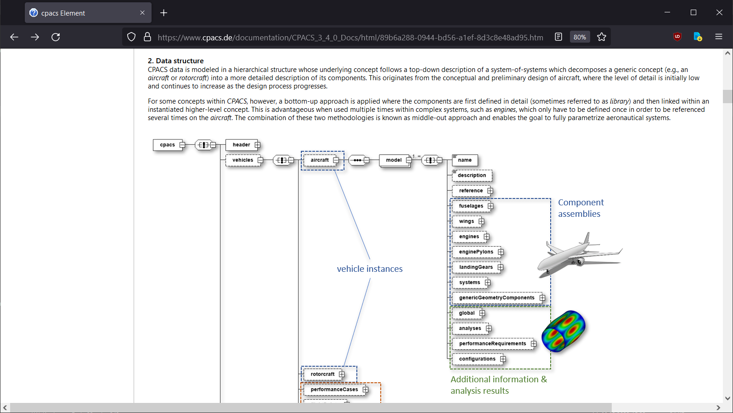
CPACS utilization

Slide 12





Connect tools to CPACS
automate
input
filter input
translate input
existing analysis module
input
selection
input
→
supporting libraries (optional)
file handling
geometry handling
execute analysis
output
merge output
translate output
updated / added
output
output
←

Slide 13
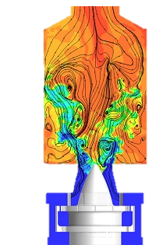
Connect tools to CPACS
automate
input
filter input
translate input
existing analysis module
input
selection
input
input
→
supporting libraries (optional)
file handling
geometry handling
execute analysis
output
merge output
translate output
updated / added
output
output
output
←

Slide 14


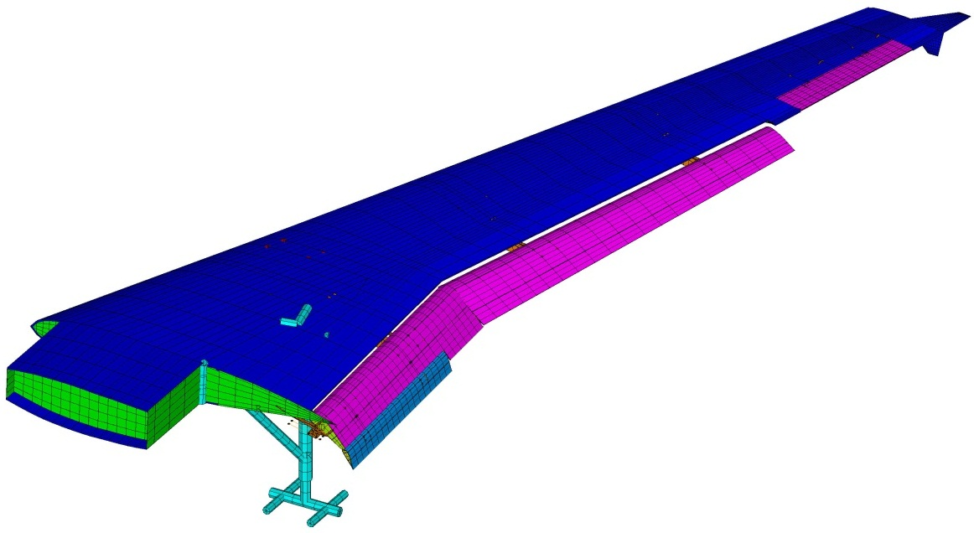

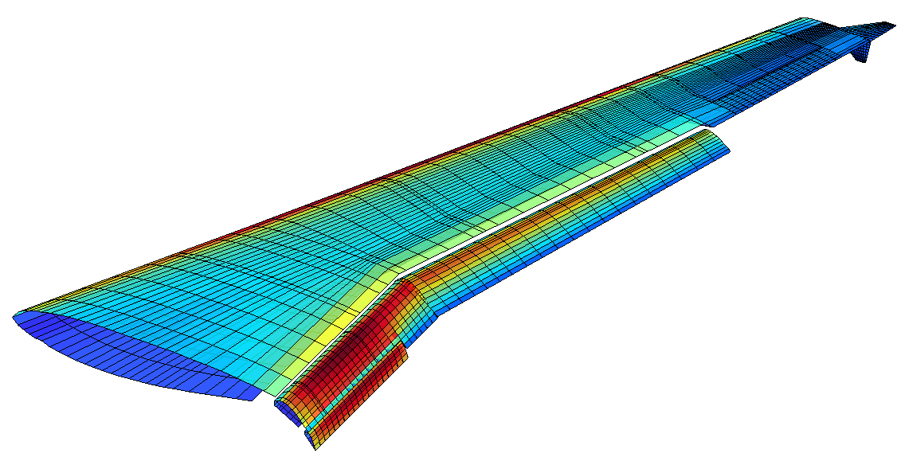
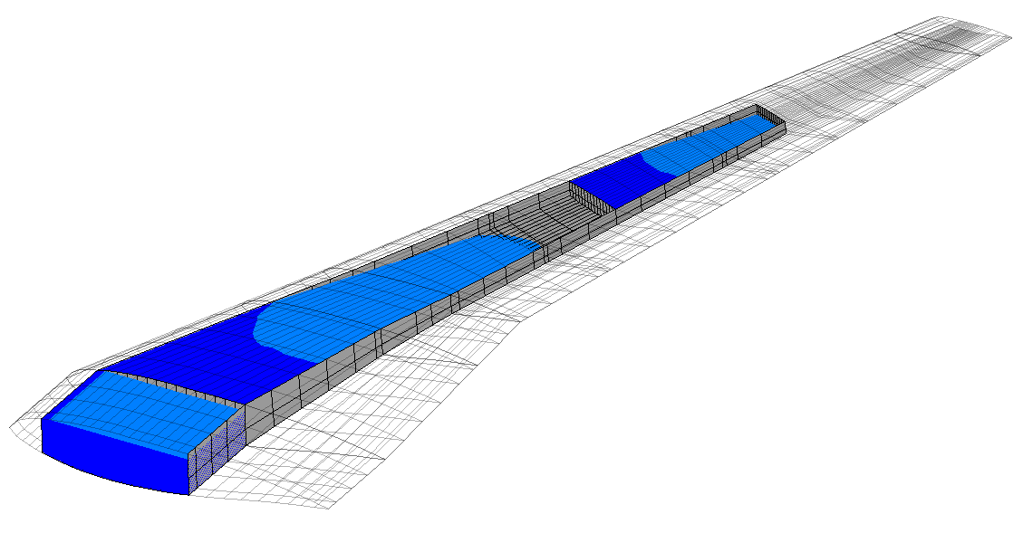
Using CPACS for parametric design
Requirements
Multi-Disciplinary Modelling
Design Optimization
Parameter
Optimization
Structure
Iteration → Synthesis
Datenbank
Engineering Service 1
MDA System
Meta-Model
Engineering Service 2
Aerodynamics
Engineering Service n
Loads
Sensitivity
Performance,
Properties
Assessment

Slide 15
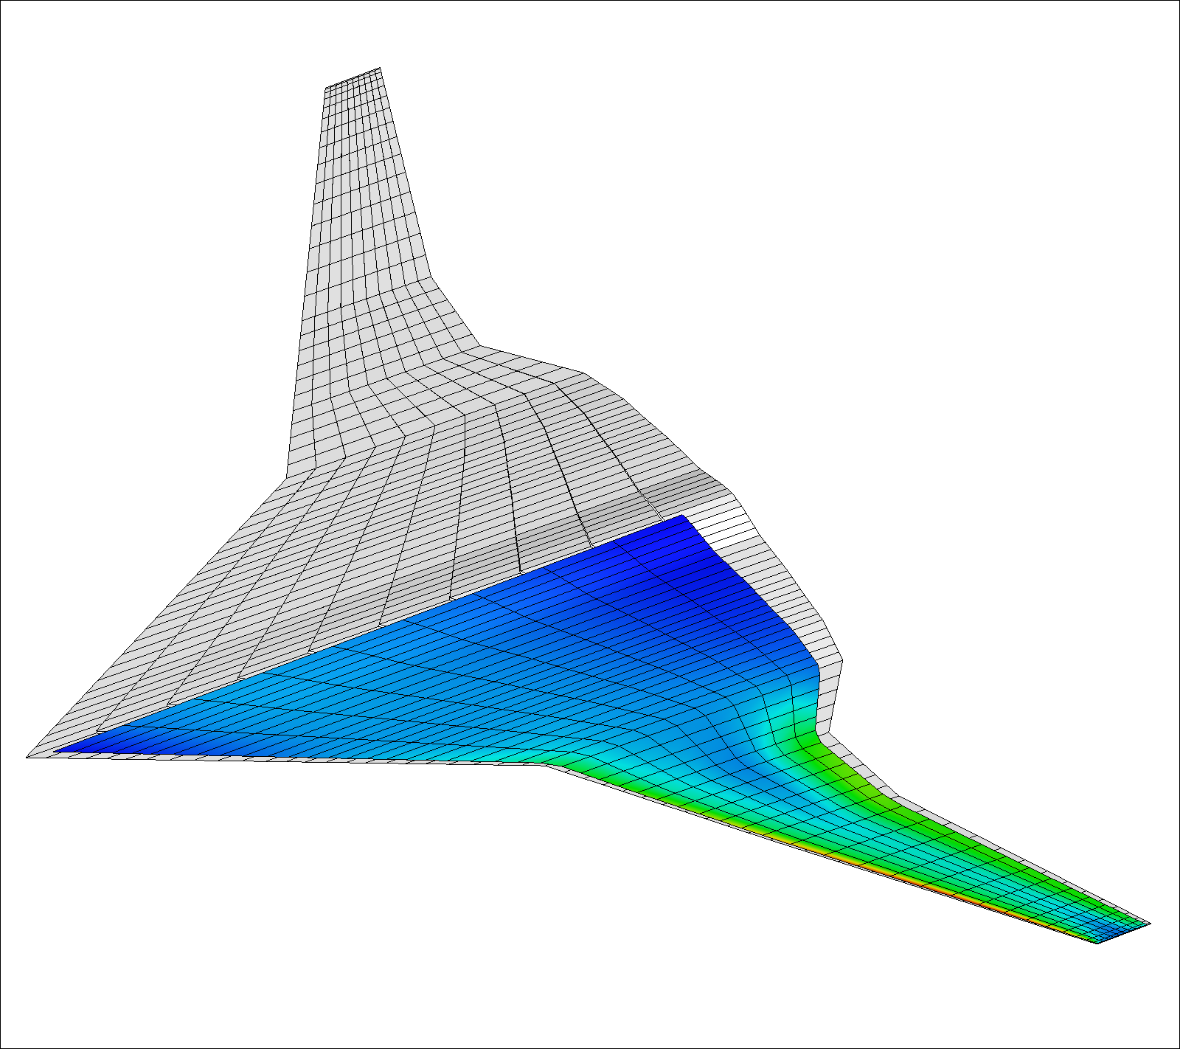
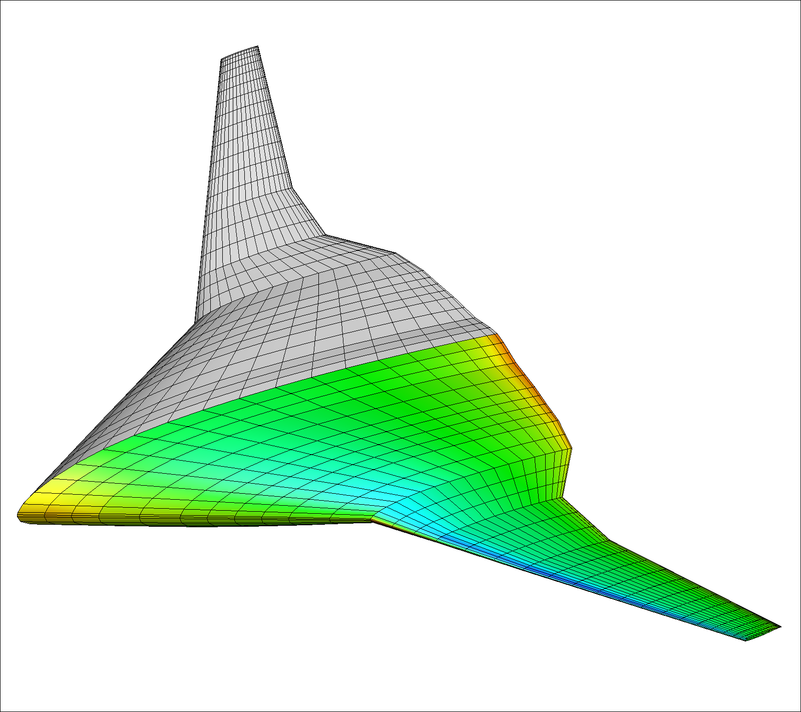
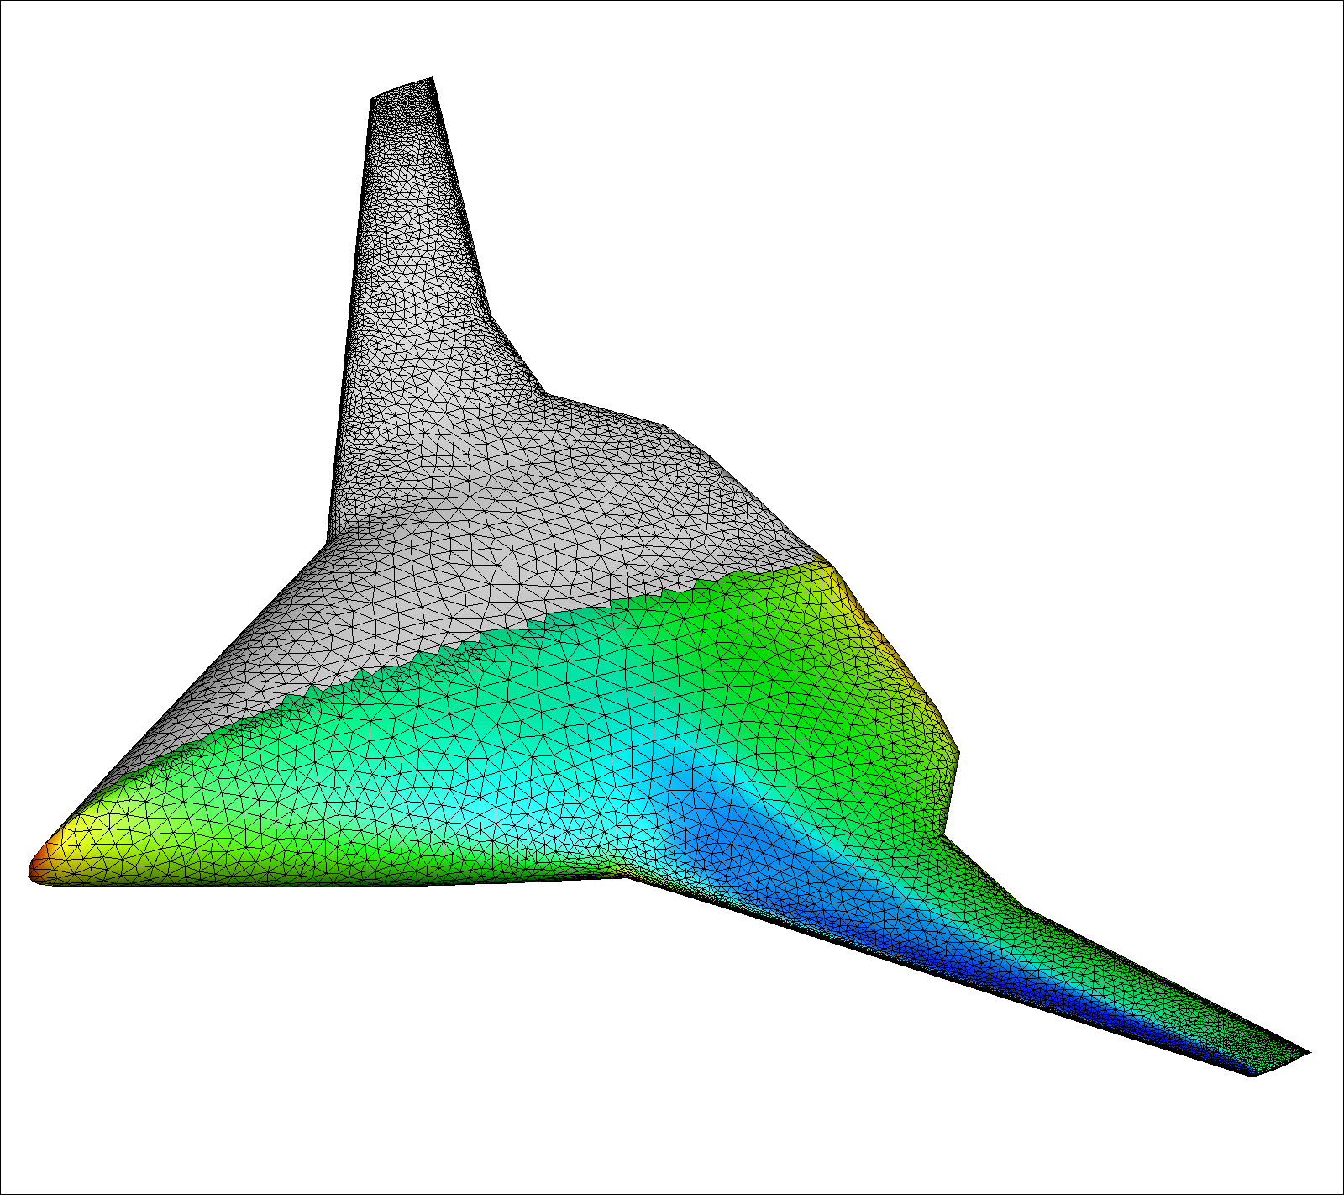
Using CPACS for parametric design
Requirements
Multi-Fidelity Modelling
Design Optimization
Parameter
Optimization
Lifting Line
Iteration → Synthesis
Datenbank
Engineering Service 1
MDA System
Meta-Model
Engineering Service 2
3D Panel
Engineering Service n
Euler
Sensitivity
Performance,
Properties
Assessment

Slide 16



Using CPACS for parametric design
Requirements
Multi-Scale Modelling
Design Optimization
Parameter
Optimization
Component
Iteration → Synthesis
Datenbank
Engineering Service 1
MDA System
Meta-Model
Engineering Service 2
Aircraft
Engineering Service n
Fleet
Sensitivity
Performance,
Properties
Assessment

Slide 17






Documentation, support and further information
Homepage
download, news, newsletter, online help, link to other parts of eco-system
GitHub
version management, Q&A forum
www.cpacs.de
https://github.com/DLR-SL/CPACS
 cpacs@dlr.de

